Slide 1
From
Aa to Gg

Slide 2
Click each letter to watch the video
Aa
Bb
Cc
Dd
Ee
Ff
Gg
From A to G Challenge

Slide 3
✍🏽Aa

Slide 4
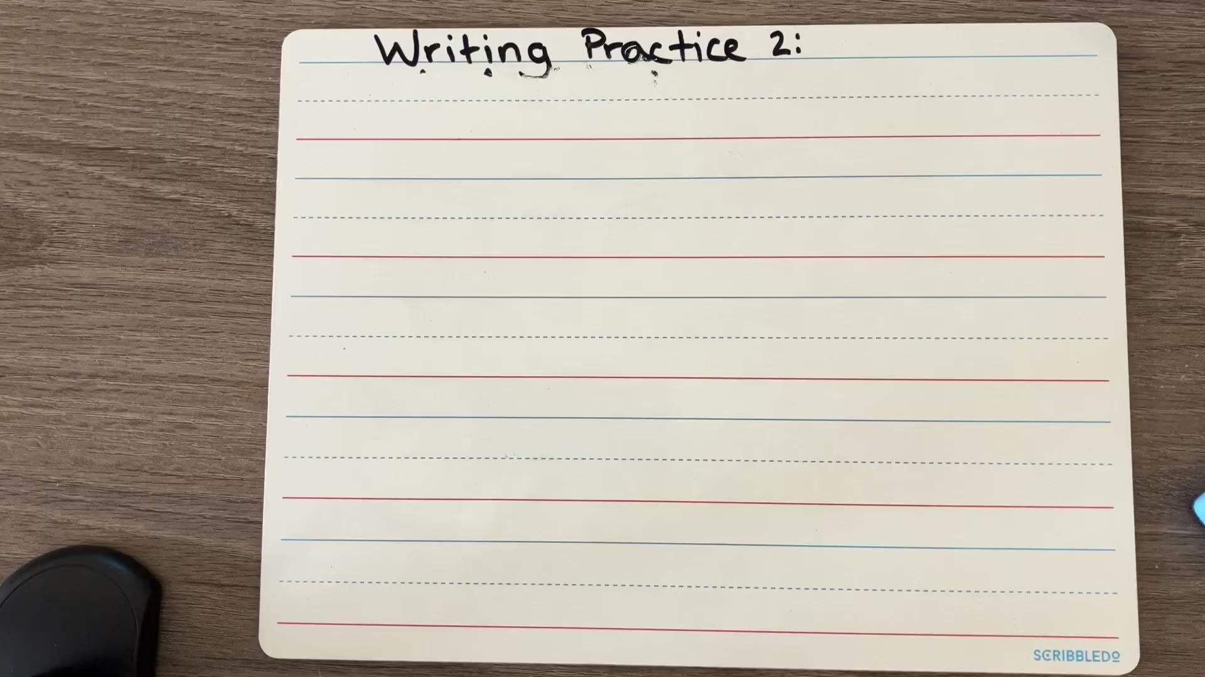
✍🏽Bb

Slide 5
✍🏽Cc

Slide 6
✍🏽Dd

Slide 7
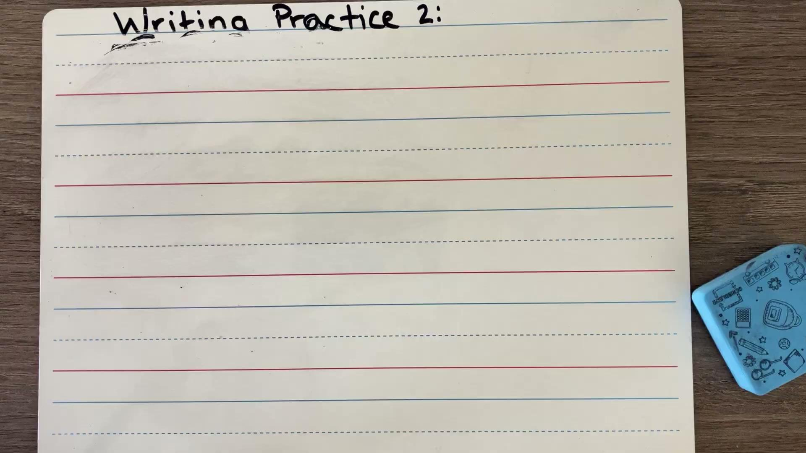
✍🏽Ee

Slide 8
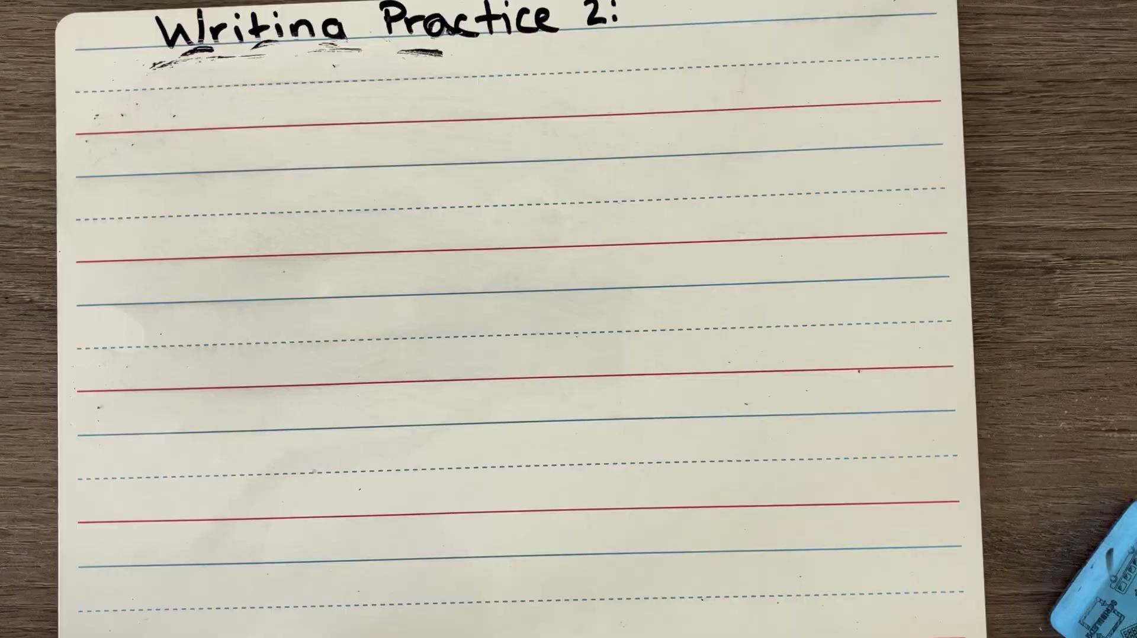
✍🏽Ff

Slide 9
✍🏽Gg

Slide 10
🎉A to G Challenge ⌛

