Slide 1
Handwriting Introduction

Slide 2
How to hold a pencil
Spacing and Lines
3. Strokes

Slide 3
How to hold a pencil

Slide 4
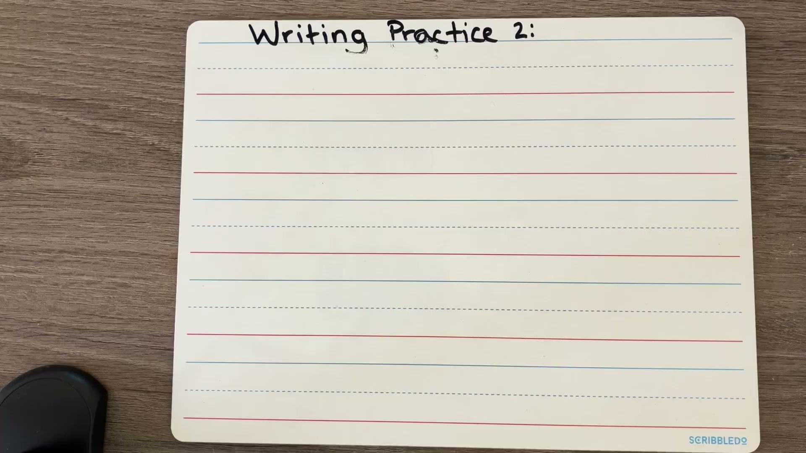
Spacing and lines

Slide 5
Strokes

